Slide 1
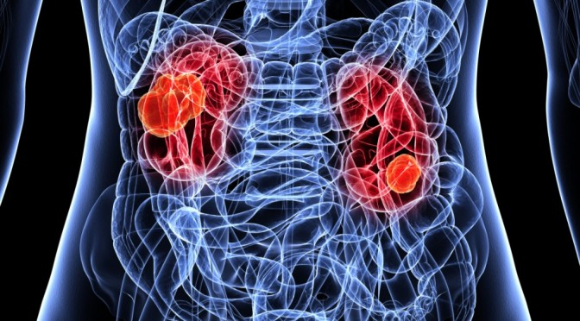
topic05 team02 kidney cancer
project proposal

Slide 2
Research question
Identification of kidney cancer drugs

Slide 3
Next steps
Loss of information if we condense prism to prism.drug.means?
Is there a mode of action which is more represented?
Correlation between gene expression & copy number & treatment effect
Identification of housekeeping /tumor supressor genes
Identification of thresholds

Slide 4
Milestones and timetable
Data cleanup
cleaned data set
Data exploration
Visualization of data distribution
Data reduction
cluster of samples
Data modelling
project presentation
Until 17.05. 23.05. 7.06. 28.06. 19.07.

Slide 5
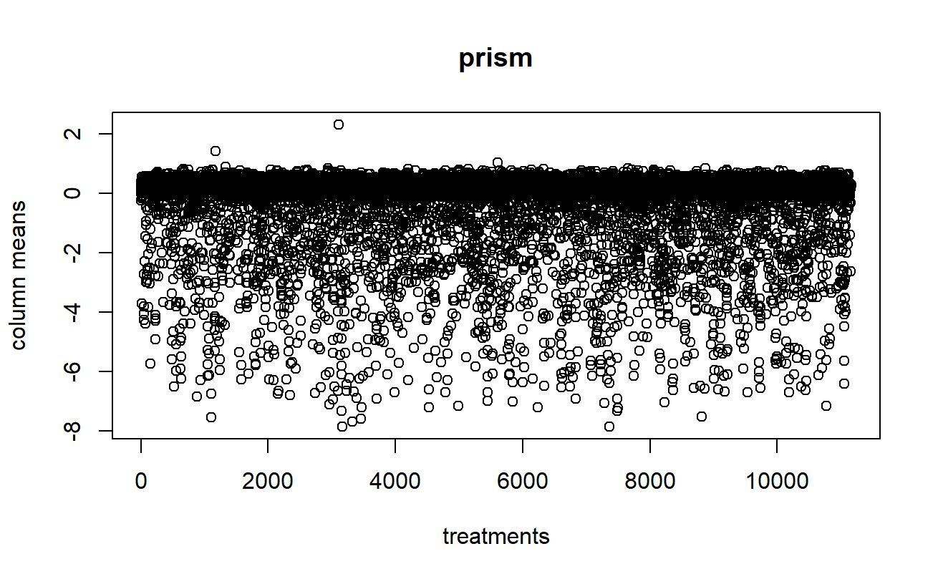
prism
 | treatment
Cell lines | Effect of treatment on cell growth

Slide 6
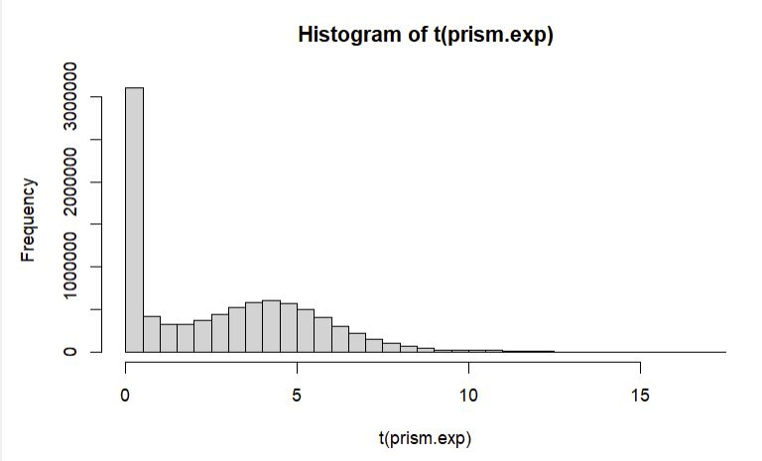
prism.exp
 | genes
Cell lines | Transcripts per million

Slide 7
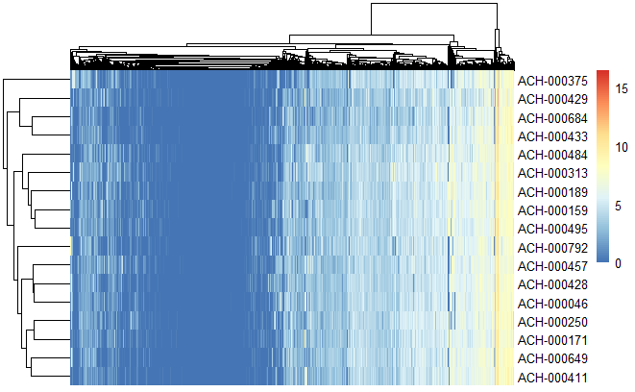
prism.exp.kidney
 | genes
Kidney Cell lines | Transcripts per million

Slide 8
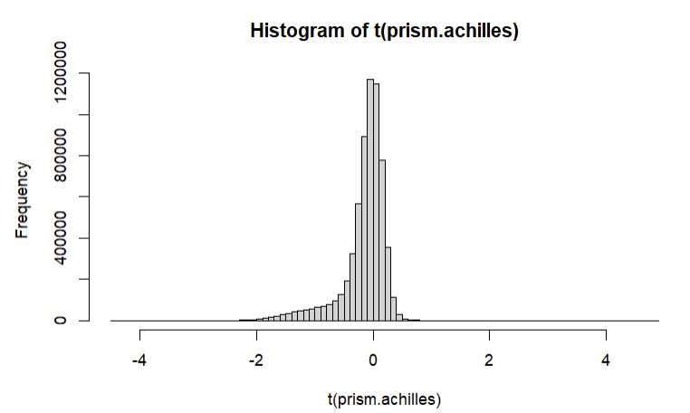
prism.achilles
 | genes
Cell lines | Gene knockout-scores

Slide 9
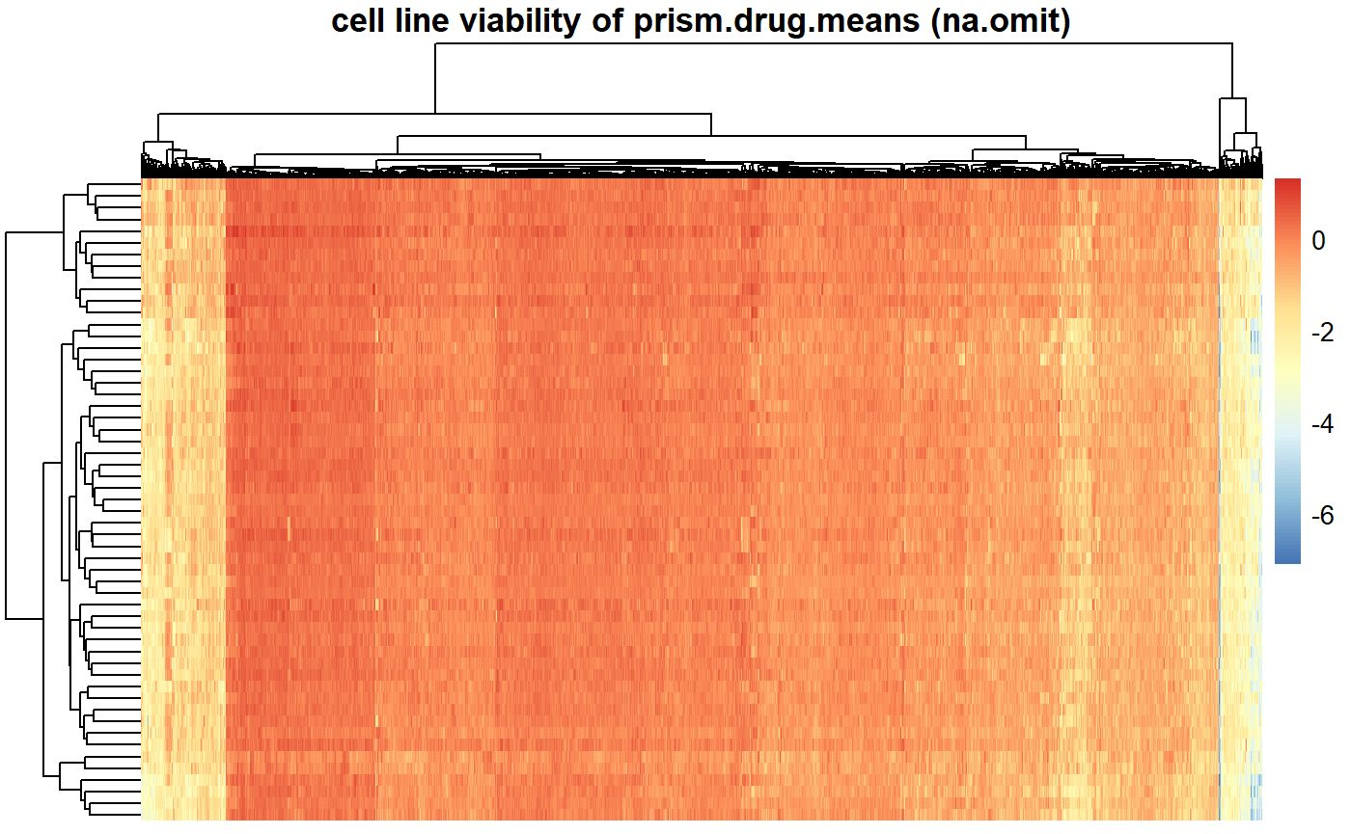
prism.drug.means
 | Treatment mean
Cell lines

Slide 10
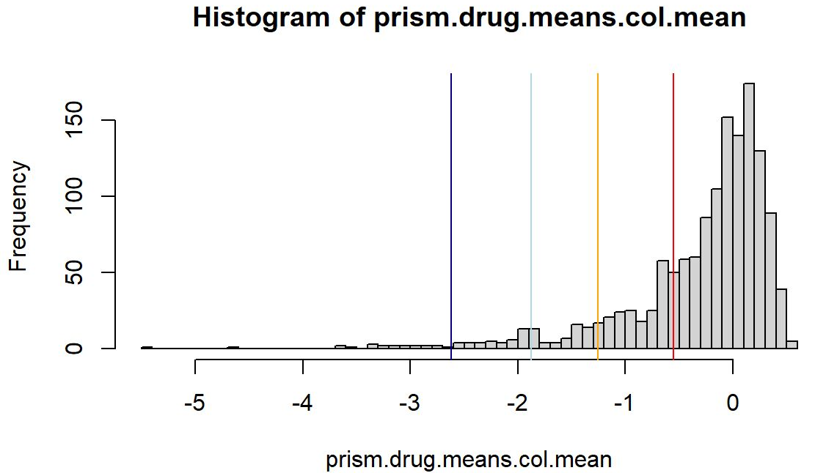
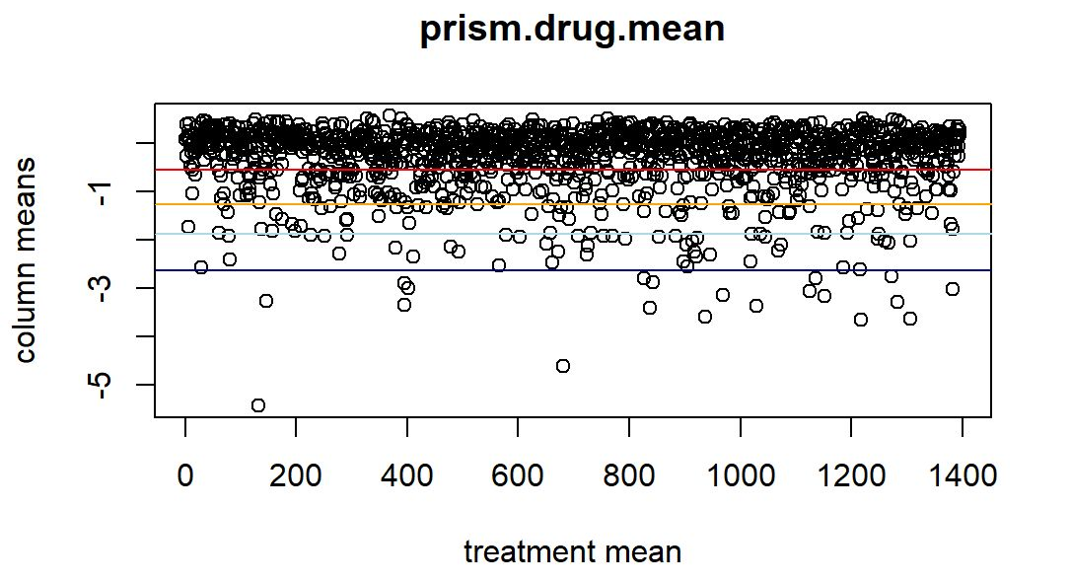
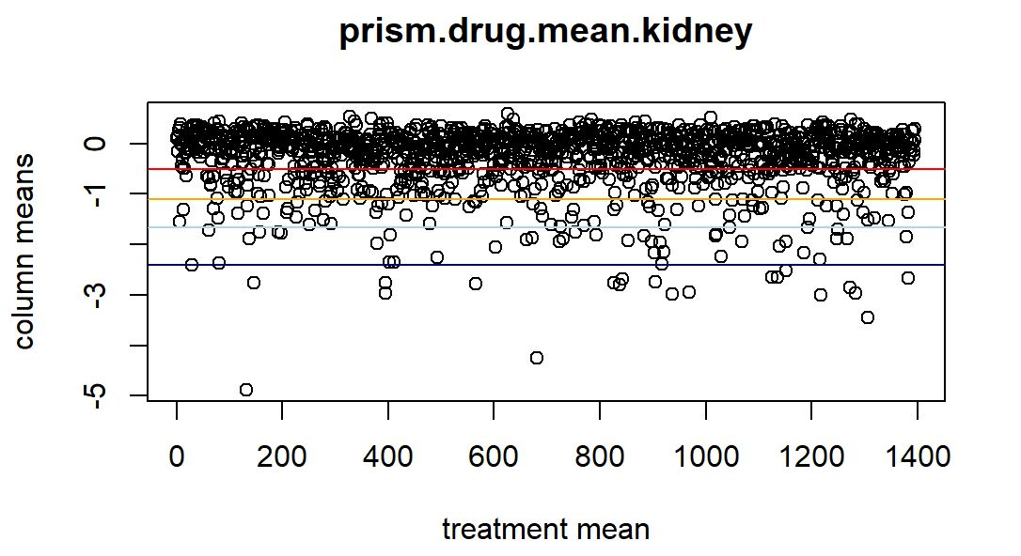
prism.drug.means
 | Treatment mean
Cell lines

Slide 11
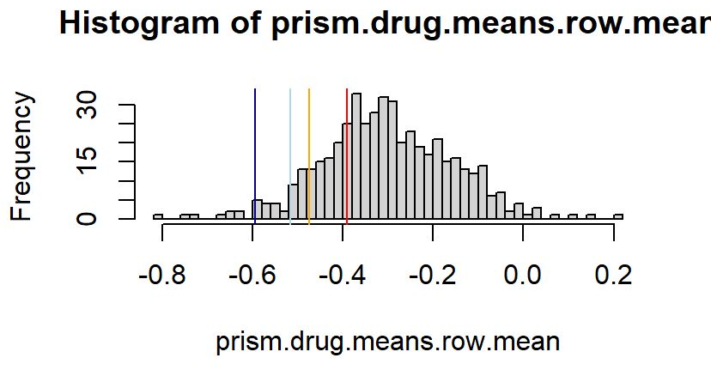
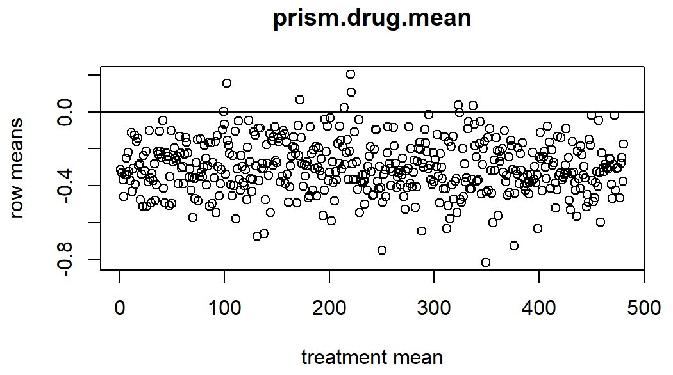
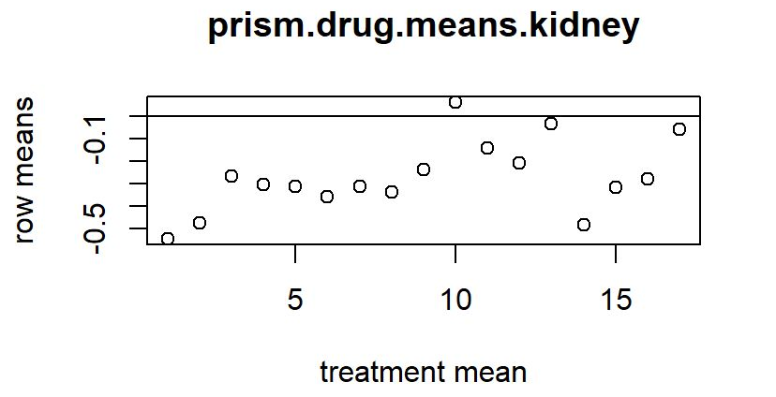
prism.drug.means
 | Treatment mean
Cell lines

Slide 12
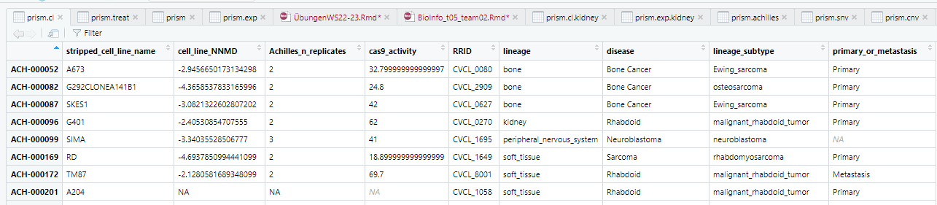
prism.cl

Slide 13
prism.cnv
 | genes
Cell lines | Copy number

Slide 14
"Dieses Foto" von Unbekannter Autor ist lizenziert gemäß CC BY

